Slide 1
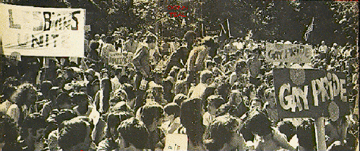
Stonewall Riots
Stonewall Riots
Jorge Andrade
Professor Danielle Carr

Slide 2
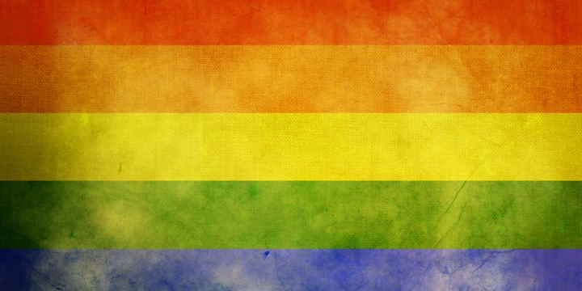
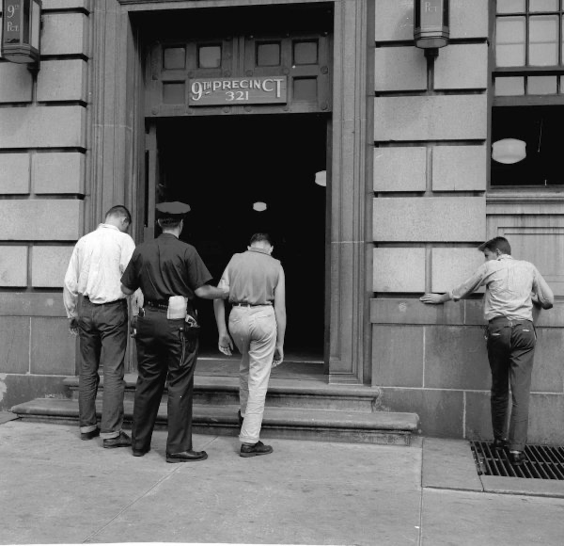
Gay Life in the 1960’s
Being gay was illegal.
Being gay was considered to be an ilness.
Many gay people would be sent to instutes where they would recieve eletrical pulses to try and be cured.
New York Law: Disorderly Conduct
Discrimation for being gay.

Slide 5
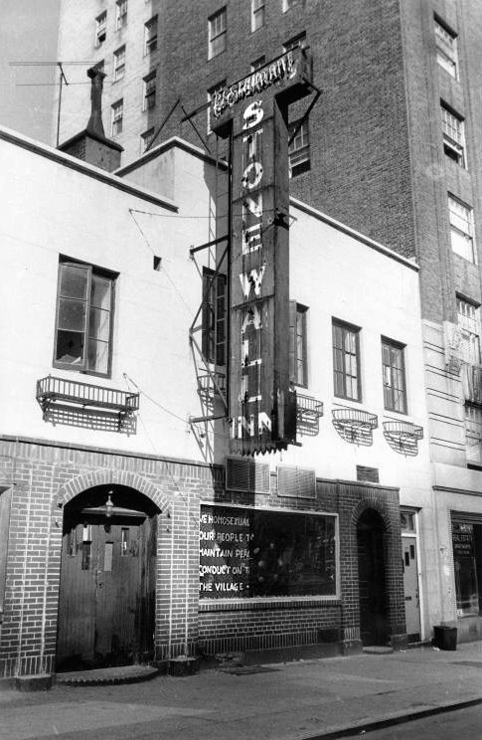
Stonewall Inn
It was a gay bar and a nightclub located in Greenwich Village, New York.
Was owned by the Genovese family.
It was a safe haven for many members of the LGBTQ+ members to be who they wanted to be freely without any judgement.
The Mafia family (Genovese family) paid $1,200 to the police to limit the amount of raiding that would happen there.

Slide 6
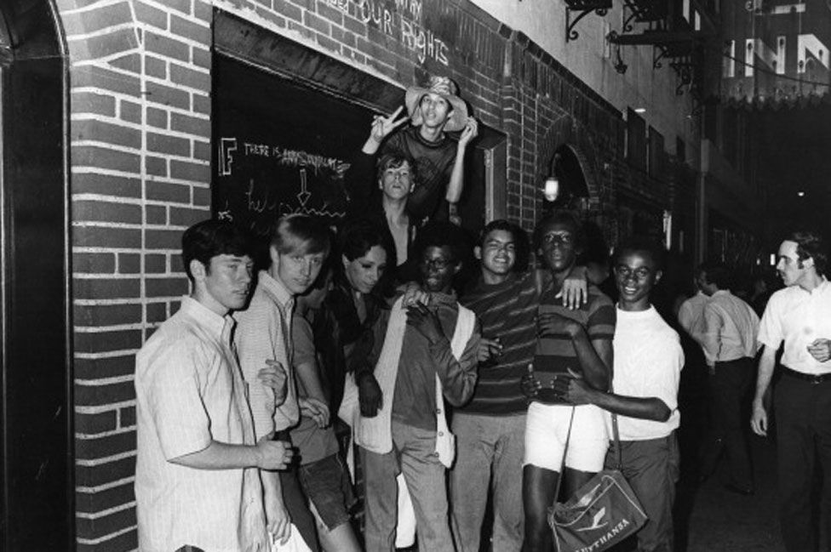

Slide 7
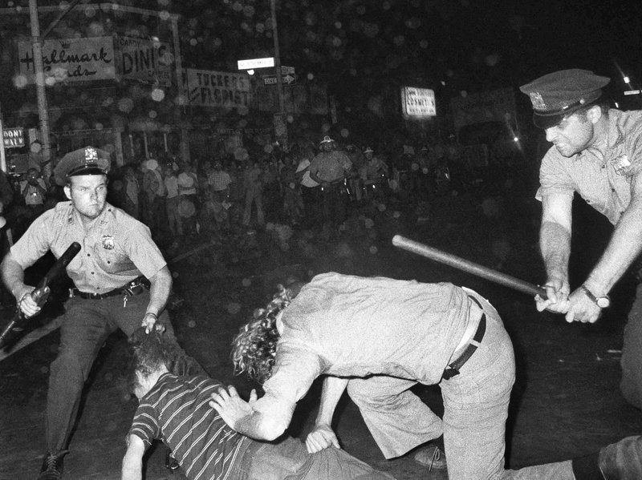
Before the Riot
Members of the LGBTQ+ community went to the bar/nightclub for some excitement.
Although the Genovese family paid the police to limit the amount of raiding happening, they often raided the Stonewall Inn.
Police would charge people them with solicitation of homosexual relation.
There was never any resistance towards the police when they raided.

Slide 9
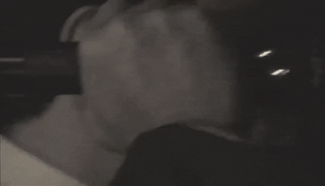

Slide 10
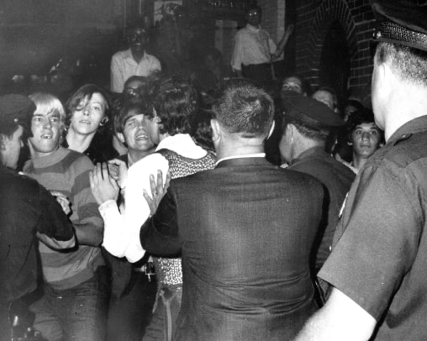
Stonewall Riots
June 28th, 1969
Police raided the gay bar trying to arrest gay and trans people.
Many resisted and fought back.
Crowds were forming outside the bar where people threw trash, coins and bottles and the Inn as a way of fighting back, causing the police to lock themselves inside of the Inn and call for backup.
Many people joined the riots standing up for what they believe in.
The riots lasted 5 days.
Each day more people joined and came out.

Slide 12
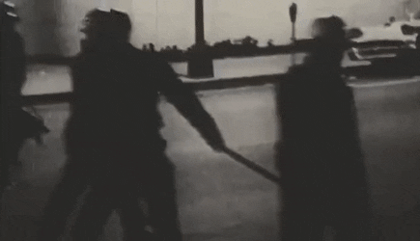

Slide 13
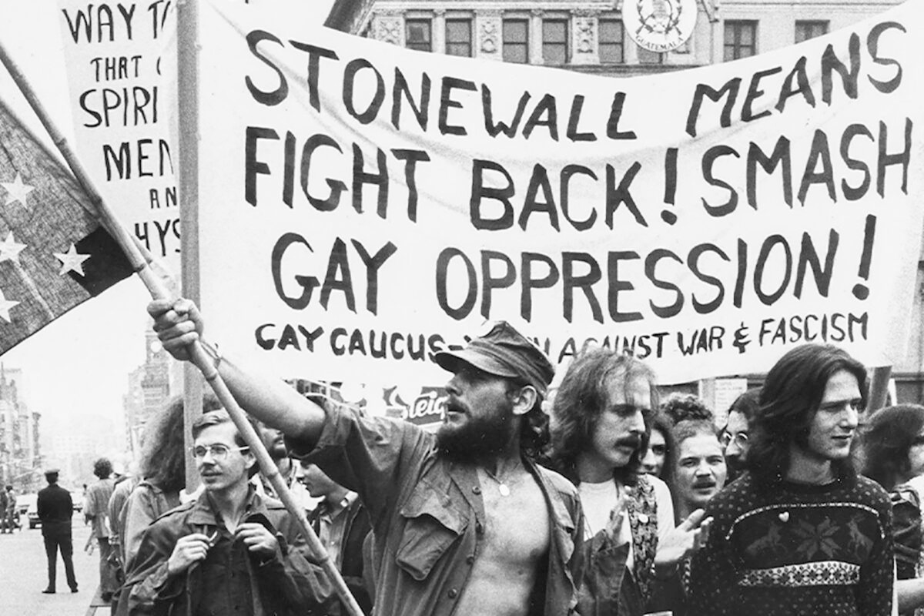

Slide 14
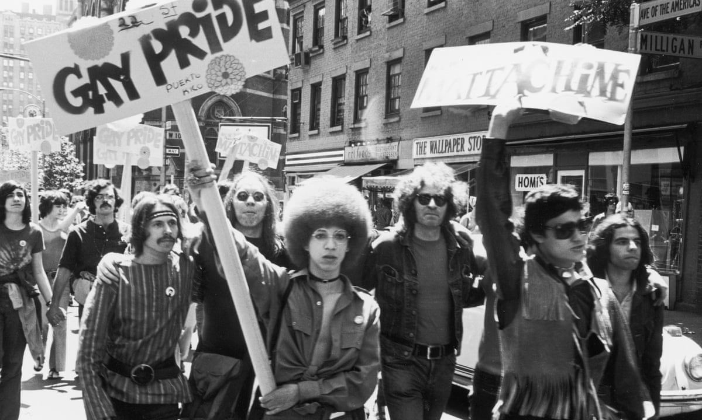
Outcome
Stonewall Riots was the beginning of the Gay Liberation Movement.
The Gay Liberation Front publicly advocated for equal gay rights.
Pride Parade
Stonewall Inn became a national monument.
Many can freely be with who they want and be what they want without being judged.
James O’Neill NYPD’s police commissioner gave a public apology to members of the LGBTQ+ community for acts of police brutality

Slide 16
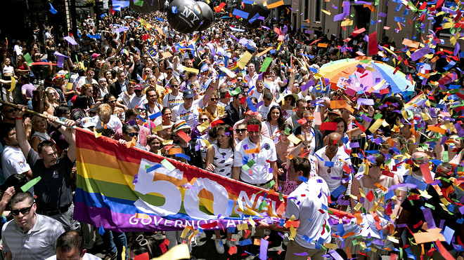

Slide 17
Sites
https://www.thedailybeast.com/how-the-mafia-muscled-in-and-controlled-the-stonewall-inn?ref=scroll
https://www.cambridge.org/core/books/american-literature-in-transition-19501960/gay-and-lesbian-literary-culture-in-the-1950s/57C5AC80B6E0F859CFAEA4514030583F/core-reader
https://www.history.com/topics/gay-rights/the-stonewall-riots
https://www.baruch.cuny.edu/nycdata/disasters/riots-stonewall.html

